Slide 1
Patients’ Rights and Advocacy
Patients’ Rights Office
Notes:
This PowerPoint Template incorporates Master Slides—meaning that a master layout controls the look of the entire presentation. There are 4 master slide layouts—a title layout (shown here), a one column layout (slide 2), a two column layout (slide 3), and a 2 column layout with titles above (slide 4). When you insert a new slide, you are given these 4 “master layout” choices. To change the Department and Division titles, please see the instructions on slide 2.

Slide 2
Your County Patients’ Rights Team
CHIEF PATIENTS’ RIGHTS ADVOCATE:
Mariam Aldaz, LMFT Program Manager I
Gavina Urena, Office Assistant III
PATIENTS’ RIGHTS ADVOCATE TEAM:
Jennifer Arnold Weaver, Clinical Therapist II
Kellie Bougard Jordan, Clinical Therapist II
Jose Orrostieta, Social Worker II
Sally Mitchell, Social Worker II
Angelica Rea, Social Worker II
Bethany Sahagun, Social Worker II Trainee
Clinical Therapist I-Vacant
Notes:
When you change the information (Department and Division) on each of these 4 default master slides, your presentation will automatically change to reflect it. **Please be sure to change the information on each of the 4 master slides.**

Slide 3
Presentation Training Objectives
Brief Overview of the Lanterman-Petris-Short (LPS) Act
Overview of County Patients’ Rights Advocacy
Patients’ Rights
Involuntary/Voluntary Status
5150 information - Application and goals
5250 information - Application and goals
Due Process, Representation and LPS Facilities Responsibilities
Discharge Planning - SB 1152 Discharge Planning for Homeless Patients
Minors Rights and Considerations
Notes:
When you change the information (Department and Division) on each of these 4 default master slides, your presentation will automatically change to reflect it. **Please be sure to change the information on each of the 4 master slides.**

Slide 4
Mission Statement for Patients’ Rights
Our mission and function for San Bernardino County Patients’ Rights Advocates is to protect the legal, civil and human rights of all behavioral health consumers in our County.
Our goal is achieved by:
Supporting the patients’ expressed needs
Rigorous monitoring of our LPS Facilities and Locked Residential Facilities
Providing Patients’ Rights training to behavioral health providers
Advocating and promoting the treatment of patients with dignity and respect
Notes:
When you change the information (Department and Division) on each of these 4 default master slides, your presentation will automatically change to reflect it. **Please be sure to change the information on each of the 4 master slides.**

Slide 5
Brief History and Intent of Lanterman-Petris-Short (LPS) Act
HISTORY:
Signed into law in 1967
Applies to mentally disordered, developmentally disabled and mentally impaired due to chronic alcoholism
Governs involuntary civil commitment for psychiatric treatment
Established a state Patients’ Rights Office/Advocacy System
INTENT of LPS:
To end inappropriate, indefinite, and involuntary commitment
To provide prompt evaluation and treatment
To safeguard individual rights through judicial review
To encourage the full use of all existing agencies
To provide individualized treatment, supervision, and placement services through a conservatorship program
To protect mentally challenged persons from criminal acts
To guarantee and protects public safety

Slide 6
The Advocacy System
State mandated system:
The State Office of Patients’ Rights (California Office of Patients’ Rights/COPR)
State Hospital Patients’ Right Advocates (Patton, Metro…)
County Patients’ Rights Advocates (SB County, Riverside Co., LA Co…)
Focus is expressed interest:
Represent expressed interest of the client as defined by the client
Do not determine what is “appropriate” or in the “best interest” of the client
Different from a traditional clinical approach

Slide 7
Authority of Patients’ Rights Advocates
County Patients’ Rights Advocates (PRAs) shall:
Have access to all patients and other recipients of behavioral health services in any BH facility, program, or services at all times as are necessary to investigate or resolve specific complaints
Have access to BH facilities, program, and services and recipients of services during normal working hours and visiting hours for other advocacy purposes
Have the right to interview all persons providing the patient with diagnostic or treatment services
Meet privately with patients
Provide notification of the availability of advocacy services and information about patients’ rights by distributing educational materials and discussion in groups and with individual patients
Inspect and copy patient records with patients’ authorization
Welfare and Institution Code (WIC) 5522-5546

Slide 8
The Value of Advocacy
For Behavioral Health (BH) Consumers:
Help resolve problems; increases patients autonomy, dignity, self-esteem, independence
For Mental Health Professionals:
Advocates are an extra pair of hands; assist in improving communication, diffuse tension & resolve conflict; improves patient’s functioning level /sense of self when they are empowered
For Mental Health Facilities:
Advocates external position helps identify systemic problems; assist in the development /improvement of P&P’s; Assist in preventing future patients’ rights complaints and/or violations; helps the Behavioral Health System become more responsive to patient concerns; improves the delivery of behavioral health services

Slide 9
Patients’ Rights
For clarification, Patients’ Rights have be divided into two groups:
Undeniable: Cannot be denied
Constitutional Rights: Rights guaranteed to all people by the Federal Constitution and California Law
Treatment Rights: Rights related to treatment
Deniable: Can be denied with “Good Cause”
Relevant to inpatient or residential facilities
May not be waived by the person, guardian, or conservator
Upon admission to a facility each client shall immediately be given a copy of a California DHCS Mental Health Patients’ Rights Handbook (WIC 5325).

Slide 10
Constitutional & Treatment Rights –Undeniable Rights
Dignity, privacy, and humane care
Religious freedom & practice
Physical exercise & recreational opportunities
Social interaction & participation in community activities
Free from harm: “Unnecessary or excessive physical restraint, isolation, medication, abuse, or neglect”
Treatment services that promote independence
Least restrictive treatment
Prompt medical care
Participate in appropriate programs of publically funded education (minor’s right)
Free from hazardous procedures

Slide 11
More Treatment Rights (Undeniable)
To consent or refuse to consent to treatment including antipsychotic medication
Except in an “EMERGENCY”
To see & receive the services of a patient advocate
To refuse psychosurgery
To language services
Confidentially
Informed consent to treatment & medication
Participate in individualized treatment planning
To be informed of complaint procedures and appeals process
Inspect & obtain a copy of their medical record
An aftercare plan
WIC 5325.1, 5325.2, 5327, 5328, 5622

Slide 12
Treatment with Antipsychotic/Psychotropic Medication
Antipsychotic medication may only be administered to a patient under the following circumstances:
Informed Consent: Signed by patient or authorized by physician’s signature…
Court Order: Medication Capacity Hearing (“Med Comp” / Riese Hearing)
Emergency: Defined by WIC 5008 (m), 5332 (e) and CCR Title 9 section 853
Consent of LPS Conservator:
Only if the conservator is granted this power
Always review Conservatorship Letters to determine who holds the power to consent/refuse treatment with medication
WIC 5332

Slide 13
Inpatient Rights (Deniable)
These rights may only be denied with “GOOD CAUSE”:
Wear own clothing
Keep & use personal possessions
Keep and be allowed to spend a reasonable sum of money (residential facilities)
Have access to individual storage space for private use
To see visitors every day
Have reasonable access to telephones; to make and received confidential calls or to have such calls made for them
Have ready access to letter-writing materials; to mail and received unopened correspondences
To refuse ECT (only deniable under WIC 5326.7)
WIC 5325

Slide 14
Good Cause for Denial of Rights
Good Cause exists when the Professional Person in Charge (PIC) or designee has good reason to believe that the right, if exercised:
Would be injurious to the patient or others
Would seriously infringe on the rights of others
Would cause serious damage to the facility
AND
There is no less restrictive way of protecting the interest specified
The justification must be related to the specific right denied
Rights shall not be denied as a punitive measure or for the convenience of staff
Rights shall not be considered a privilege to be earned
Rights cannot be waived or denied as a treatment modality
WIC 5326, CCR Title 9 Section 865.1

Slide 15
Documentation of Denial of Rights (DOR)
Each Denial of Right (DOR):
Shall be noted in the treatment record
Date & time of the DOR
Specific right denied
Good cause for DOR
Date of review if denial was extended beyond 30-days
Signature of the Professional PIC or designee authorizing the DOR
Patient shall be told of the content of the DOR notation
Each DOR shall be documented regardless of the gravity of the reason, the frequency a right is denied in a particular facility, or for a particular individual.
CCR Title 9 Section 865.3

Slide 16
Restoration of Rights
A right shall not continue to be denied when “good cause” no longer exists.
Staff should use the least restrictive means of managing the behavior problem which led to the DOR
The date a right is restored shall be documented in the patient’s treatment record
CCR Title 9 Section 865.5

Slide 17
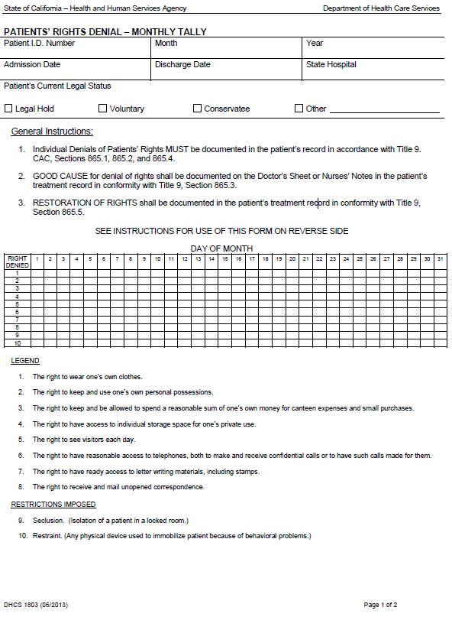
Denial of Rights –Monthly Tally (DHCS 1803)
Quarterly, each local behavioral health director shall provide to the Director of Health Care Services (DHCS) the facility reports of the number of persons whose rights were denied and the right or rights which were denied.
WIC 5326.1, CCR Title 9 Section 866

Slide 18
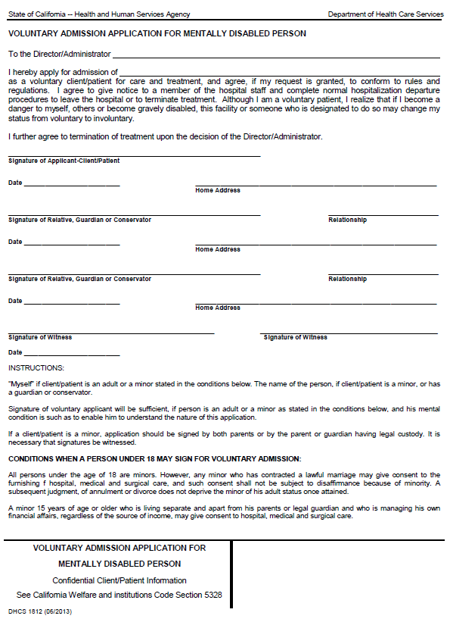
Acute Inpatient Psychiatric Services & LPS Regulations for Involuntary Treatment
WIC 5003: “Nothing in this part shall be construed in any way as limiting the right of any person to make a voluntary application at any time to any public or private agency or practitioner for mental health services, either by direct application in person, or by referral from any other public or private agency or practitioner.”
PLEASE NOTE: LPS requires assessment for voluntary treatment (VOL) prior to initiating any involuntary hold.

Slide 19
LPS Involuntary Holds -in San Bernardino County
Danger to Self (DTS), Danger to Others (DTO), and Gravely Disabled (GD)
WIC 5150 (DTS, DTO, or GD): Up to 72-hours psych evaluation, crisis intervention and/ or treatment
Written by Peace Officers or County Authorized Writers
WIC 5585 (DTS, DTO, or GD): Same as 5150, but for Minors
WIC 5200 (DTS, DTO, or GD): Court Ordered Psych Evaluation up to 72-Hours
Petitioned by an individual in the community and must be ordered by Superior Court Judge
WIC 5250 (DTS, DTO or GD): Up to 14-days for Intensive Psychiatric Treatment
Initiated by treating psychiatrist
WIC 5260 (DTS only ): Detention up to 14-additional days; Imminent Threat for Suicide
Initiated by psychiatrist
WIC 5300 (DTO only): Detention up to 180-additional days; Imminently dangerous person
Court Process
Temporary Conservatorship/LPS Conservatorship (GD only): Court Process
PLEASE NOTE: The WIC 5270 detention, up to an additional 30-days for GD, is not authorized in SB County.
WIC 5150 - 5372

Slide 20
Definitions of Gravely Disabled (GD)
Adult: “Gravely disabled” means:
A condition in which a person, as a result of a mental health disorder or impairment by chronic alcoholism, is unable to provide for his or her basic personal needs for food, clothing, or shelter.
A person is not “gravely disabled” if that person can survive safely without involuntary detention with the help of responsible family, friends, or others who are both willing and able to help provide for the person’s basic personal needs for food, clothing, or shelter.
The term “gravely disabled” does not include persons with intellectual disabilities by reason of that disability alone.
Minor: “Gravely disabled minor” means:
A minor who, as a result of a mental disorder, is unable to use the elements of life that are essential to health, safety, and development, including food, clothing, and shelter, even though provided to the minor by others.
Intellectual disability, epilepsy, or other developmental disabilities, alcoholism, other drug abuse, or repeated antisocial behavior do not, by themselves, constitute a mental disorder.
WIC 5008 (h)(1)(A), 5008(h)(2), 5008(h)(3), 5250 (d)(1), 5585.25

Slide 21
WIC 5150: Involuntary Detention up to 72-hours
When a person as a result of mental disorder is a DTS, DTO, or GD, a peace office or authorized writer may, upon probable cause, take or cause a person to be taken into custody up to 72-hour for assessment, evaluation, and crisis intervention, or placement for evaluation and treatment in a county designated facility*.
If the person can be properly served without being detained, then he or she shall be provided services on a voluntary basis.
A preadmission assessment (WIC 5151) to determine the appropriateness of involuntary detention must be completed prior to admitting a person to the designated facility for treatment
*San Bernardino County designated facilities include:
VAMC-Loma Linda -Fully Designated
ARMC -Fully Designated
Loma Linda University Behavioral Medicine Center
Canyon Ridge Hospital
Community Hospital of San Bernardino-BH Units Only
WIC 5150, 5151

Slide 22
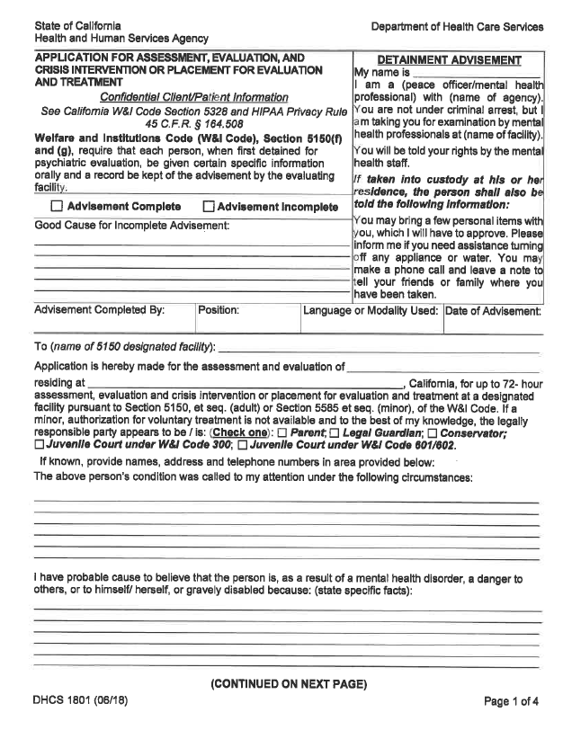
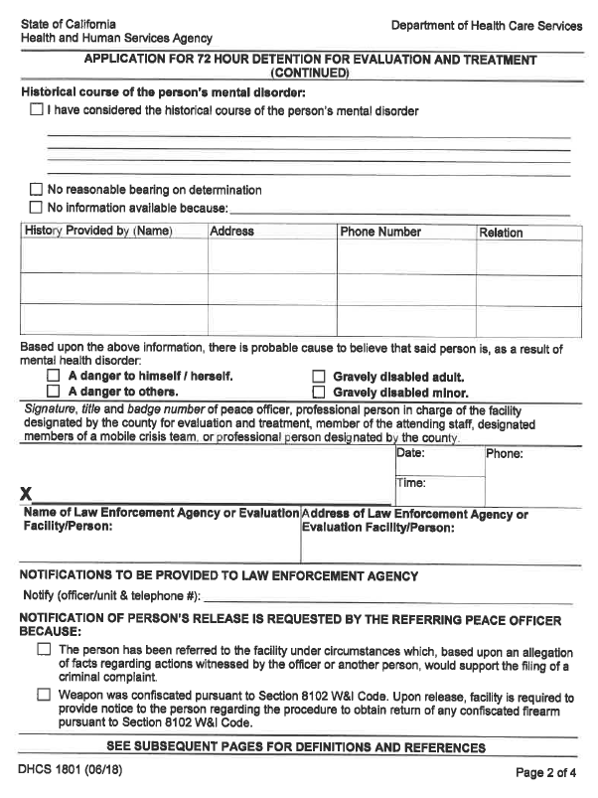
“5150 Application”: DHCS 1801 (06/18)
Please Remember…
The 5150 Application may only be initiated and completed by a peace officer or an authorized writer of the County.
WIC 5150

Slide 23
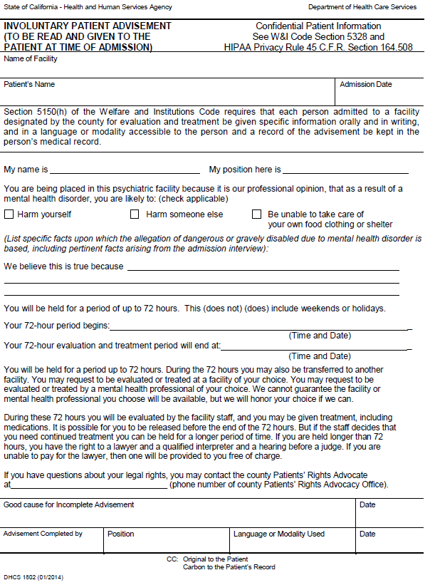
Involuntary Patient Advisement: DHCS 1802
Each person admitted to a facility designated by the county for evaluation and treatment shall be given the following information (orally and in writing) by admission staff of the facility:
In a language or modality accessible for the person
In English and the language that is the primary means of communication
Must include phone number to county Patients’ Rights Office
WIC 5150 (h)

Slide 24
Prior to expiration of 72-Hours
Before the 5150 expires, the patient must be assessed for a safe discharge or of needing further treatment.
If needing further treatment:
Assess for voluntary treatment (willing and able)
An application for voluntary treatment must be signed and/or authorized by the MD
If no VOL, and meets criteria, 5250 Hold for Intensive Treatment:
MD order for 5250
Notice of Certification must be written, signed and delivered
Documentation of legal status change (VOL or 5250) before the 72-hour expires is necessary to determine if further involuntary detention was legally imposed by the facility.
WIC 5250, 5259.1

Slide 25
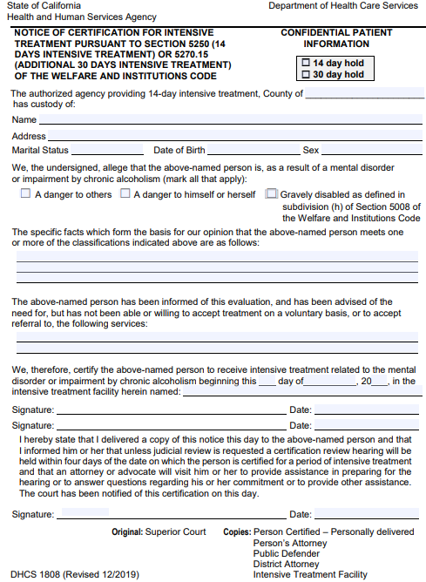
WIC 5250: Certification for Intensive Treatment
WIC 5250: Detention for Intensive Treatment
Detention for no more than 14-days.
Criteria determined by a recent psychiatrist assessment.
Criteria: DTS/DTO and/or GD; Mental Disorder or Chronic Alcoholism.
Notice of Certification document signed by 2-people.
First, the psychiatrist or physician or designee that performed the evaluation shall sign signature on illustrated 1st arrow.
Second, signature can be a psychiatrist, physician, psychologist, LMFT or LCSW or R/N who participated in the evaluation.
Copy personally delivered to patient and patients’ attorney or advocate.
Copy also goes to any person designated by the patient as soon as capable of designating.
WIC 5251, 5252, 5253.
1st
2nd

Slide 26
Delivering the Notice of Certification
The person delivering a copy of the Notice of Certification to the patient shall, at the time of delivery:
Inform the patient they are entitled to:
A CRH within 4-6 days to determine if probable cause exists, unless judicial review is requested.
Be informed of the rights with respect to the hearing, including the right to the assistance of another person to prepare for the hearing and to answer questions and concerns regarding their involuntary detention.
Inform the patient of their right to:
Request a judicial review by habeas corpus
(writ of habeas corpus).
Explain the term, “writ of habeas corpus”.
Inform patient of right to counsel, including court-appointed counsel.
Sign the attestation at the bottom of the 5250.
WIC 5254-5254.1
3rd Signature

Slide 27
5250 & Due Process Rights
Why do we do Hearings?
The Fifth Amendment of the United States Constitution states, "No person shall be…deprived of life, liberty, or property, without due process of law.”
“To safeguard individual rights through judicial review” is also an intention of the LPS Act cited in WIC 5001(d).
Due process is guaranteed to patients’ detained by LPS provisions by way of a:
Certification Review Hearing (CRH) aka “5250 Hearing”
Informal Probable Cause Hearing
Officiated by a Administrative Hearing Officer
Automatically scheduled
Writ of Habeas Corpus aka “Writ”
Formal Request for Release-Court Hearing
Officiated by a Superior Court Judge
May only be requested by the patient or patients’ representative, advocate, or attorney

Slide 28
Due Process and Representation
Role and Responsibility of the Patients’ Rights Office:
Meet with the patient to explained the 5250 and Certification Review Hearing (CRH) process
Assist the patient in preparing for the CRH
Answer any other questions about their involuntary detention and due process rights
Represent the patient at the CRH
Role and Responsibility of the Mental Health Court:
Writ of Habeas Corpus (Attorney meets/represents patient)
Medication Capacity Hearing – aka “Med Comp” or “Riese Hearing” (Attorney meets/represents patient)
Temporary Conservatorship Process – aka “T-CON” (Attorney meets/represents patient)
LPS Conservatorship Hearings and other Court Hearings (Attorney meets/represents pt.)

Slide 29
LPS Facility and Certification Review Hearing
Role and Responsibility of the LPS Facility:
Facilitate access to necessary legal documents to the County Patients Rights Office
Provide a private space for the patient and the patients’ advocate to meet
Provide a location for the CRH that is private and least disruptive to the patients’ treatment
Develop policies/procedures to ensure compliance and uniformity with implementing the CRH process
WIC 5250: If a person is detained for 72 hours and has received an evaluation, he or she may be certified for not more than 14 days of intensive treatment under the following conditions…
The facility providing intensive treatment is designated by the county to provide intensive treatment, and agrees to admit the person. No facility shall be designated to provide intensive treatment unless it complies with the Certification Review Hearing…

Slide 30
WIC 5275: Writ of Habeas Corpus (Request for Release)
REMEMBER…
Every person detained by WIC 5250 shall have the right to a hearing by Writ of Habeas Corpus for his or her release.
The request for a Writ of Habeas Corpus:
Can be made by the patient or person acting on patients’ behalf (advocate, attorney or authorized representative)
Can be made to any member of the treatment staff (review current facility protocol)
Can be made at any time during the 14-day period of detention; before and after Certification Review Hearing
If Writ is requested prior to the Certification Hearing, then no Certification Hearing

Slide 31
Discharge Planning: HSC 1262, WIC 5622, WIC 5768.5
When a mental health patient is being discharged the patient and the patient’s conservator, guardian, or other legally authorized representative shall be given a written aftercare plan prior to the patient’s discharge from the facility. The written aftercare plan shall include, to the extent known, all of the following components:
The nature of the illness and follow up required
Medications including side effects and dosage schedules
Expected course of recovery
Recommendations regarding treatment that are relevant to the patient’s care
Referrals to providers of medical and mental health services
Other relevant information
The patient shall be advised by facility personnel that he or she may designate another person to receive a copy of the aftercare plan
A patient who is released from the facility may refuse any or all services under the written aftercare plan
Each hospital shall have a written discharge planning policy and process (HSC 1262.5)
Aftercare plan for minors shall include educational or training needs, provided these are necessary for the minor’s well-being (WIC 5585.57)

Slide 32
SB 1152 Discharge Criteria for the Homeless
On January 01, 2019, hospitals needed to add a homeless patient discharge planning policy and process. The newly required elements of the written policy are:
Purpose of Policy
Ask patient about housing status; document answer
Nondiscrimination provision
Provide information about discharge to patient in a culturally competent manner
An individual discharge plan must be prepared for each homeless patient
Discharge planning will be guided by the best interests of the homeless patient, his or her physical and mental condition, and his or her preferences for placement
How to identify a post-discharge destination for each patient
Services that must be offered to the homeless patient prior to discharge
Maintain a log of homeless patients discharged and the destinations to which they were released after discharge (by July 01, 2019)

Slide 33
SB 1152 Discharge Criteria for the Homeless (continued)
On July 01, 2019, hospitals were required to implement the written plan for coordinating services and referrals for homeless patients with the available:
County behavioral health agency
Health care and social services agencies in the region
Other health care providers
Nonprofit social services providers

Slide 34
MORE ON MINORS: Children’s Civil Commitment and Mental Health Treatment Act of 1988
Assembly Bill 4642 passed in 1988 (WIC 5585) added provisions to protect minors rights, parental rights and to address the health and welfare of the minor.
The intent of the Act is:
To provide prompt evaluation and treatment of mentally disordered minors
To safeguard the rights to due process for minors and their families
To provide individualized treatment, supervision, and placement services for gravely disabled minors
To prevent severe and long-term mental disabilities among minors through early identification, effective family service interventions, and public education
It also established a separate definition for gravely disabled minor (WIC 5585.25)

Slide 35
What is a Minor
An individual under the age of 18 years old not:
Married or divorced
Currently in active military duty
Legally emancipated by the court
Court will only emancipate a minor if all criteria met:
Be at least 14 years of age
Willing to live apart from parent or guardian
Able to manage their own financial affairs
Income is not derived from criminal activity

Slide 36
What is 5585 Hold?
WIC 5585.50 states: When a Minor, as a result of a mental disorder is a DTO, DTS and/or GD and authorization for voluntary treatment is not available:
A Peace Officer or Person Designated by the County may, upon probable cause, take or cause a minor to be taken into custody
Placed in a facility designated by the county and approved by the State Department of Health Care Services (DHCS) as a facility for 72-hour treatment and evaluation of minors.
The facility shall make every effort to notify the minor’s parent or legal guardian as soon as possible after the minor is detained
The facility shall require an application in writing stating probable cause for DTO, DTS and/or GD and authorization for voluntary treatment is not available.
* The “5585” is essentially the same at the “5150”, but has additional safeguards to prevent the unnecessary detention of minors.

Slide 37
WIC 5585.52: Clinical Evaluation
WIC Section 5585.52 requires:
Any minor detained under the provisions of Section 5585.50 shall receive a clinical evaluation consisting of multidisciplinary professional analyses of the minor’s medical, psychological, developmental, educational, social, financial, and legal conditions as may appear to constitute a problem
This evaluation shall include a psychosocial evaluation of the family or living environment, or both.
Persons providing evaluation services shall be properly qualified professionals in the diagnosis and treatment of minors
Every effort shall be made to involve the minor’s parent or legal guardian in the clinical evaluation

Slide 38
Voluntary Hospitalization
If minor requires psychiatric evaluation or hospitalization:
Voluntary admission should be considered prior to placing a minor on any involuntary hold
WIC 5585 requires every reasonable attempt to be made to engage the parent in the assessment process and seek the parents’ consent to voluntarily admit their child to the hospital, if that level of care is recommended
If the parent is not available, willing and/or capable of voluntarily signing their child into the hospital, then the child should be placed on involuntary detention per WIC 5585.50
If the minor is a Dependent or Ward of the Court, voluntary admission is less of an option and involuntary detention per WIC 5585.50 is appropriate in most cases

Slide 39
What is a Roger S. Hearing
THIS IS NOT A 5250 HEARING!!
A Roger S. Hearing is a pre-commitment hearing provided in a public psychiatric facility:
Hearing is for minors over the ages 14-17
Automatically scheduled when a minor is “voluntarily” admitted by parent
Minor patient must be given notice and information about the hearing
The hearing is a private, informal meeting held at the facility within five days after minor is signed in voluntary by parent or legal guardian
Hearing must be before a judge or administrative officer of the court
Minor has a right to counsel
Hearing may be waived only by the minor
Minors due process rights cannot be waived by a parent or guardian

Slide 40
CONTACT PATIENTS’ RIGHTS FOR TECHNICAL ASSISTANCE
San Bernardino County
Behavioral Health Patients’ Rights Office
850 E. Foothill Blvd. Rialto, CA 92376 Phone: 909-421-4657 Toll Free: 800-440-2391 Fax: 909-421-9258
Our job is to create a county in which those who reside and invest can prosper and achieve well-being.
www.SBCounty.gov.

Slide 41
References
Receive and maintain quarterly reports of denial of patients’ rights from mental health facilities submitted in accordance with Title 9 CCR Section 866
Receive & investigate complaints from concerning patients about violations or abuse of their rights (WIC Section 5520 [a], Title 9 CCR Section 863.2)
Protect mentally disordered persons & developmentally disabled persons from criminal acts (WIC Section 5001 [g])
Space to interview patient in privacy (WIC Section 5530 [c])
To inspect & copy patient records. Authorization by patient or guardian ad litem or conservator (WIC Section 5541)
WIC Sections 5325 and 5325.1 are two categories: Right that are non-deniable and rights that are subject to denial
Title 22 CCR Section 73523: individuals are to be fully informed at the time of admission & during their stay of P.R and rules and regulations governing individual conduct
Notification of Rights: individuals must be notified of their rights with documentation placed in the patient’s record with in 24 hours of admission Title 9 CCR Section 862
Client have statutory right to see & receive services of P.R advocate who has no direct or indirect clinical or administrative responsibility for person receiving mental health services (WIC Section 5325 [h])
Right to least restrictive treatment (WIC Section 5325.1)
Monitor mental health facilities, services & programs for compliance with patients rights laws, regulations & policies (WIC Sections 5520[a], Title 9 CCR Section 863.2)
Emergencies: Allows for administration of medication only to the degree for the duration, needed to address the emergency and addressed in the least restrictive manner. This means administering smaller rather than larger dosage amounts and only shorter acting medications (Title 9 CCR Section 853)
Antipsychotic Medications defined as any drug customarily prescribed for treatment of symptoms of psychoses and other severe mental and emotional disorder (WIC Section 5008(I), Title 9 CCR Section 856)
Legal Standard for Voluntary Patients Status: It is necessary that facility make initial determination of the appropriateness of voluntariness and determination must also be evaluated on a continuing basis (WIC Sections 5003, 5150 (c) )
Facility has an affirmative obligation to inform a voluntary patient of the right to be discharged on his/her won choice & information must be given at time of admission Title 9, CCR Section 865
Certification Review Hearing: (WIC Sections 5256.1, 5256.4)
Conservatee’s Rights: Patients Rights Advocacy services may not be waived or denied by the conservator (WIC Section 5324 (i) )

