Slide 1
AB2275: LPS Act Amendments to Expand Due Process Rights
Patients’ Rights Office
Notes:
This PowerPoint Template incorporates Master Slides—meaning that a master layout controls the look of the entire presentation. There are 4 master slide layouts—a title layout (shown here), a one column layout (slide 2), a two column layout (slide 3), and a 2 column layout with titles above (slide 4). When you insert a new slide, you are given these 4 “master layout” choices. To change the Department and Division titles, please see the instructions on slide 2.

Slide 2
Your County Patients’ Rights Team
CHIEF PATIENTS’ RIGHTS ADVOCATE:
Mariam Aldaz, Program Manager I- Chief Patients’ Rights Advocate
Gavina Urena, Office Assistant III
PATIENTS’ RIGHTS ADVOCATE TEAM:
Jennifer Arnold Weaver, Clinical Therapist II
Kellie Bougard Jordan, Clinical Therapist II
Jose Orrostieta, Social Worker II
Sally Mitchell, Social Worker II
Angelica Rea, Social Worker II
Bethany Sahagun, Social Worker II Trainee
Clinical Therapist I-Vacant

Slide 3
Patients’ Rights Mission Statement
Our mission is to protect the legal, civil and human rights of all behavioral health consumers in San Bernardino County.
Our mission is achieved by:
Supporting patients expressed needs
Monitoring of LPS-designated facilities and locked residential facilities
Providing Patients’ Rights training to behavioral health providers
Advocating and promoting the treatment of patients with dignity and respect

Slide 4
Presentation Training Objectives
LPS Act Intent
AB2275
Background
Purpose and Intent
What Does it Require?
Due Process Rights
New Responsibilities of Non-Designated Facilities
Role of County Patients’ Rights Office
LPS Holds and Hearings
AB2275 – Entities Impacted
AB2275 – Factors to Consider for Implementation
References

Slide 5
Lanterman-Petris-Short (LPS) Act Established in 1967
Intent of LPS Act [Welfare and Institutions Code (WIC) §5001 et seq.]:
To end inappropriate, indefinite, and involuntary commitment
To provide prompt evaluation and treatment
To safeguard individual rights through judicial review
To encourage the full use of all existing agencies
To provide individualized treatment, supervision, and placement services through a conservatorship program
To protect mentally challenged persons from criminal acts
To guarantee and protect public safety

Slide 6
Assembly Bill (AB) 2275 Background
In December 2021, a committee gathered to examine the application of LPS Act and how it may be improved.
It was noted that there was significant inconsistencies of LPS Act implementation across the state.

Slide 7
AB2275 - Purpose and Intent
According to the authors, Jim Wood (A) , Mark Stone (A):
“The past several years have seen an intensified focus on the LPS Act and its effectiveness in serving one of the most vulnerable populations – that of the severely mentally ill. The dramatic increase in substance use and homelessness has only exacerbated the concern that our systems of treatment and care are failing to adequately and appropriately serve our citizens most in need of mental health services. Attempts to expand the definition of “gravely disabled” or “harm to self or others” and other bills aimed at modifying or expanding the LPS Act have grown exponentially year by year. At the center of this issue is the nexus of how to provide involuntary care or treatment while at the same ensuring that individuals’ civil liberties are not violated.”

Slide 8
AB2275 - Purpose and Intent, cont’d.
Amends WIC Sections 5150, 5151, 5256, 5275, 5350, 5354, and 5585.20
Approved by Governor Newsom and Chaptered on September 30, 2022
Effective January 01, 2023

Slide 9
AB2275 - Summary of Provisions
Specifies 72-hour period of detention begins at the time when a person is first detained
Removes time constraints for postponement of the Certification Review Hearing (CRH)
Requires any facility who detains a person pursuant to WIC 5150 to notify the County Patients’ Rights Advocate if a person has not been released within 72 hours of the hold
Requires a CRH to be held within 7 days of the date the person is initially detained when a person has not been certified for 14-day intensive treatment and remains detained on a 72-hour hold
Requires the person in charge of the county designated facility, or an individual designated by the county if the person is not in a designated facility, to notify the detained person of specified rights.
Extends the right to a Writ of Habeas Corpus to every person detained under this part if held in a any facility longer than 72 hours
Applies AB2275 provisions equally to minors
Notes:
5350 hold allows P.O & mental health professionals to take individual into custody if believe that your mental illness, likely to cause or suffer specific kinds o of home. Timeline (d) (2) . Court or jury trial shall commence within 10 days of the date of the demand, except that the court shall continue the trial date for a period not to exceed 15 days upon the request of counsel for the proposed conservatee. Failure to commence the trial within that period of time is grounds for dismissal of the conservatorship proceedings

Slide 10
LPS Due Process Hearings
Certification Review Hearing
aka “Probable Cause Hearing”
Administrative Hearing (informal); not a Court Hearing (formal);
Required / Automatically scheduled;
Must be held within 4-days after “certification” and if not certified, within 7 days after WIC 5150 application; and
AB2275 applies to WIC §§ 5150, 5250 & 5270 holds.
Judicial Review by Writ of Habeas Corpus
Formal Superior Court Hearing;
Upon a request for release by the person, or anyone acting on behalf of the person being detained;
Evidentiary Hearing scheduled in accordance with SB County Superior Court procedures; and
Opportunity upon every separate detention period (see WIC §§ 5150, 5200, 5250, 5260, 5270, 5300).

Slide 11
Detention and Due Process Flow in LPS Facilities
5150 – Application
by Authorized Writer
(Detention Up to 72-Hrs)
Certification Review Hearing and/or a Writ of Habeas Corpus within seven days of the 5150 Application if a person is not released after the 72 hours
Writ of Habeas Corpus
Initiated Upon Patient Request
Superior Court Hearing
5250 & 5270 Certification
by Person in Charge of Facility/Authorized Designee
(Detention up to 14-days)
Certification Review Hearing
Required / Automatically scheduled
Must occur “within 4-days”

Slide 12
Detention and Due Process Flow in Non-LPS Facilities (AB2275)
Writ of Habeas Corpus
Now an LPS Right due to AB2275
Initiated Upon Patient Request
(Superior Court Hearing)
Question:
What is the significance of the WIC 5256(b) requirement for Certification Review Hearing to be held “within 7-days”?
Answer:
The 3 days of 5150 is added to the WIC 5256(a) requirement for a Certification Review Hearing to be held within 4-days (3+4 days= 7days)
5150-Application
by Authorized Writer
(Detention Exceeds 72-Hrs)
Certification Review Hearing
Required / Automatically scheduled
Must occur “within 7-days”
(Informal Hearing)

Slide 13
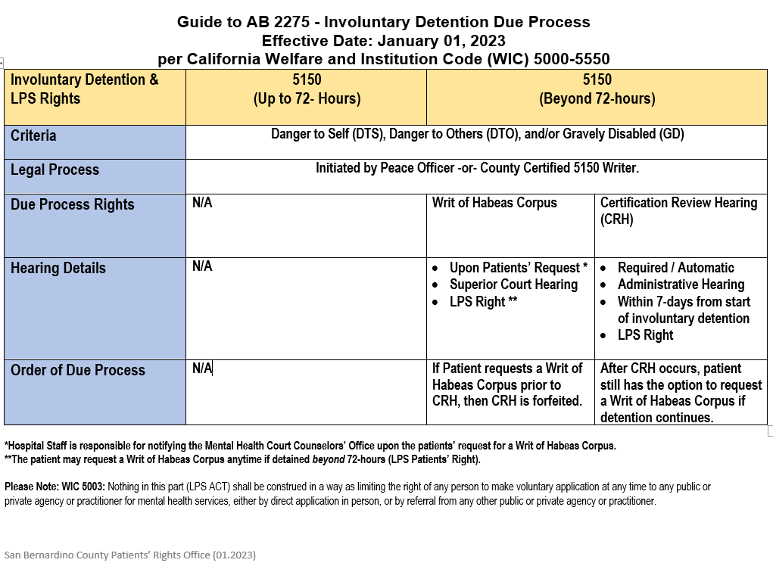
AB2275 Due Process Guide

Slide 14
AB2275 - Responsibilities of the Non-Designation Facility
Adhere to the WIC 5150 established start time of the 72-hour period of detention
Comply with WIC 5150(f) - Notify County Patients’ Rights Office of persons “not release within 72-hours”
Comply with WIC 5256(b) - CRH for person not released within 72-hours
CRH to be provided within 7-days of initial WIC 5150 detention
Comply with CRH process outlined under WIC 5256.1- 5256.7
Comply with WIC 5275 - Judicial Review (when patient requests release from detention)
Anyone acting on behalf of the patient may also make the request for release
Request may be made to any member of the treatment staff if not released after the 72 hour detention
Complete Petition for Writ of Habeas Corpus
Notify the Superior Court of the request for release IMMEDIATELY

Slide 15
AB2275 - Role of County Patients’ Rights Office
Receive notifications of persons “not released within 72-hours”
Extend advocacy services to persons detained in any facility under this part
Educate persons detained in any facility under this part on due process rights
Represent the detained person at their Certification Review Hearing
Notify DBH Director/designee of any compliance concerns

Slide 16
AB2275 - Foreseen Entities to be Affected
San Bernardino County, Department of Behavioral Health
Office of Patients’ Rights
Non-LPS designated facility who detains persons on WIC 5150
May include General Acute Hospital, Emergency Department of non-designated hospital; Crisis Stabilization Unit, and Crisis Walk-In Clinic
Superior Court of California – San Bernardino County
Mental Health Counselor’s Office
San Bernardino County Counsel and Hartnell Law Group (Patient Attorney) (Writ Hearings)
County approved Hearing Officers (Certification Review Hearings)
County designated LPS hospitals

Slide 17
AB2275 - Implementing Factors to Consider
SB County Department of Behavioral Health (DBH):
Provide guidelines to LPS-designated facilities and applicable non-designated facilities
Collaboration with County Counsel, Superior Court, Mental Health Counselor’s Office, Hearing Officers, and Patients’ Rights Advocates
SB County Patients’ Rights Office:
Receive notifications from non-designated facilities and LPS-designated facilities as required
Extend advocacy services to persons detained in any facility under this part
Educate persons detained in any facility under this part on due process rights
Represent the person detained in a non-designated facility at their CRH
Non-designated Health Facilities:
Notify County Patients’ Rights Office as required
Notification/communication with County Patients’ Rights regarding CRH
Collaboration with Superior Court, Mental Health Court Counselor’s Office, etc., regarding Writ of Habeas Corpus Hearings
SB County Superior Court- MH Court Counselor’s Office- County Counsel- Hartnell Law Group:
Implement WIC 5350 (d)(1)(2) regarding LPS Conservatorship Hearings
Collaboration with non-designated health facilities regard Writ of Habeas Corpus proceedings

Slide 18
FOR PATIENTS’ RIGHTS RELATED TECHNICAL ASSISTANCE
Patients’ Rights Office
850 E. Foothill Blvd. Rialto, CA 92376
DBH-PatientsRightsOffice@dbh.subcounty.gov
Phone: 909-421-4675 Toll Free: 800-440-2391 Fax: 909-421-9258
Our job is to create a county in which those who reside and invest can prosper and achieve well-being.
www.SBCounty.gov

Slide 19
References
Bill Text - AB-2275 Mental health: involuntary commitment. (ca.gov)

